Slide 1
Chapter 2: Operating-System Structures

Slide 2
Chapter 2: Operating-System Structures
Operating System Services
User Operating System Interface
System Calls
Types of System Calls
System Programs
Operating System Design and Implementation
Operating System Structure
Virtual Machines
Operating System Generation
System Boot

Slide 3
Objectives
To describe the services an operating system provides to users, processes, and other systems
To discuss the various ways of structuring an operating system
To explain how operating systems are installed and customized and how they boot

Slide 4
2.1 Operating System Services
从用户的角度，需要OS提供一系列服务来完成用户的需求
运行用户程序
访问计算机资源
运行时的错误检测
…
从系统的角度，OS也内核也提供一些服务来实现系统自身的功能
资源分配
审计
保护与安全
…

Slide 5
OS为用户提供的服务
Program execution
Load a program into memory
Run that program
End execution
either normally or abnormally (indicating error)
I/O operations
A running program may require I/O, which may involve a file or an I/O device.

Slide 6
OS为用户提供的服务
File-system manipulation
read and write files and directories
create and delete files and directories
search files and directories
list file Information
permission management.

Slide 7
OS为用户提供的服务
Communications
Processes may exchange information
on the same computer
between computers over a network
Communications may be
via shared memory
through message passing (packets moved by the OS)

Slide 8
OS为用户提供的服务
Error detection
OS needs to be constantly aware of possible errors
May occur in the CPU and memory hardware, in I/O devices, in user program
For each type of error, OS should take the appropriate action to ensure correct and consistent computing
Debugging facilities can greatly enhance the user’s and programmer’s abilities to efficiently use the system

Slide 9
OS为自身提供的服务
Resource allocation
When multiple users or multiple jobs running concurrently, resources must be allocated to each of them
Many types of resources
CPU cycles, main memory, and file storage
I/O devices.
Accounting
To keep track of which users use how much and what kinds of computer resources

Slide 10
OS为自身提供的服务
Protection and security
Protection involves ensuring that all access to system resources is controlled
Security of the system from outsiders requires user authentication, extends to defending external I/O devices from invalid access attempts

Slide 11
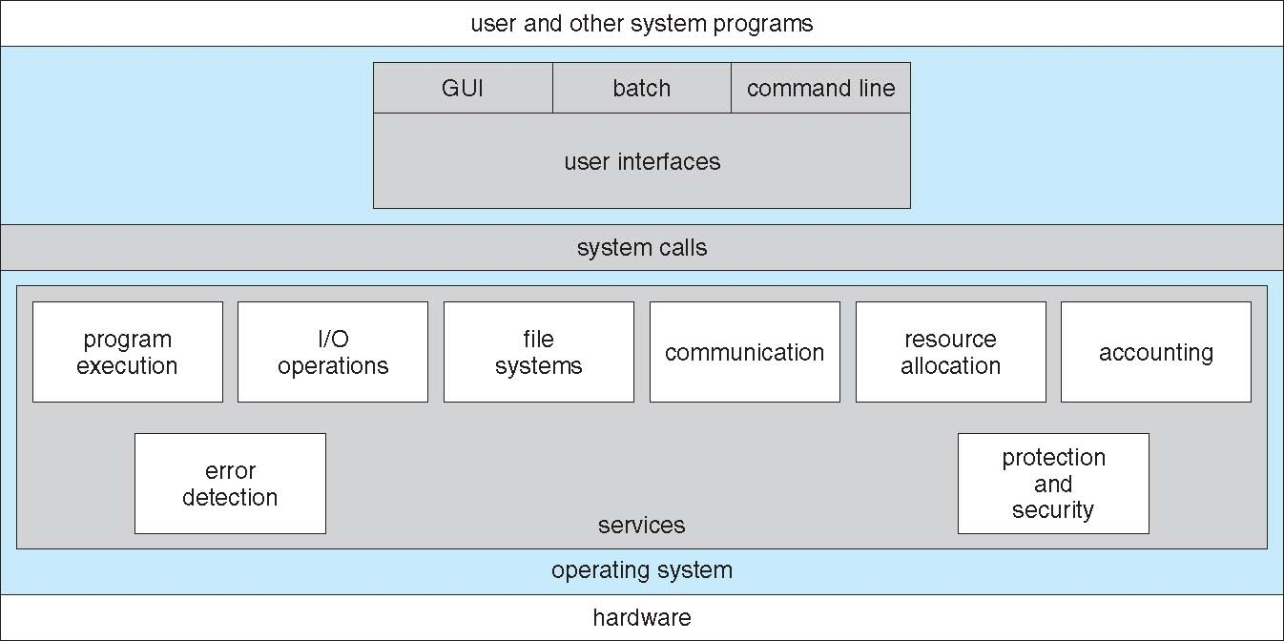
A View of Operating System Services
User interface
operating-system services helpfull to the user
Program execution
I/O operations
File-system manipulation
Communi-cations
Resource allocation
Accounting
operating-system services for efficient operation of the system itself
Error detection
Protection and security

Slide 12
A View of Operating System Services
operating-system services helpfull to the user
Program execution
I/O operations
File-system manipulation
Communi-cations
Resource allocation
Accounting
operating-system services for efficient operation of the system itself
Error detection
Protection and security

Slide 13
用户通过OS提供的接口使用这些服务
Two interfaces to those services for users
Command interface
Command-Line (CLI)
Graphics User Interface (GUI)
Batch
Programming interface
System calls
API

Slide 14
2.2 User Operating-System Interface
Command interface
CLI：Command Line Interface
GUI：Graphic User Interface
Batch

Slide 15
User Operating-System Interface

Slide 16
CLI-- Command Line Interface
CLI allows direct command entry
Command interpreter (in UNIX, it’s called a shell)
Sometimes implemented in kernel, sometimes by systems program
Sometimes multiple flavors implemented – shells
UNIX-Bourne,C,Korn,...
Windows-CMD.exe
Primarily fetches a command from user and executes it
Sometimes commands built-in, sometimes just names of programs
If the latter, adding new features doesn’t require shell modification
实验：设计实现一个简单的shell

Slide 17
GUI-- Graphic User Interface
User-friendly desktop metaphor interface
Usually mouse, keyboard, and monitor
Icons represent files, programs, actions, etc
Various mouse buttons over objects in the interface cause various actions (provide information, options, execute function, open directory (known as a folder)
Invented at Xerox PARC (Palo Alto Research Center)
Many systems now include both CLI and GUI interfaces
Microsoft Windows is GUI with CLI “command” shell
Apple Mac OS X as “Aqua” GUI interface with UNIX kernel underneath and shells available
Solaris is CLI with optional GUI interfaces (Java Desktop, KDE-K Desktop Environment )

Slide 18
Batch--User Operating System Interface
在DOS,OS/2和Windows操作系统中，批处理文件(batch file)是包含一系列命令的文本文件，由命令解释器解释执行。
批处理文件是一种简单的程序，可以通过条件语句(if)和流程控制语句(goto)来控制命令运行的流程，在批处理中也可以使用循环语句(for)来循环执行一系列命令。
批处理文件扩展名一般是.bat
例如：Windows10激活工具.bat

Slide 19
User Operating System Interface - Batch
UNIX环境下，一般采用shell script实现批处理的功能
如将下述代码存入文本文件，假设命名为myscript.sh，运行方法
（1）sh myscript
（2）修改其属性为可执行，在命令窗口运行之：./ myscript.sh
#batch-- shell script
echo "Here is an example of a shell script"
echo "1. File listing"
ls # list files
echo ""
echo “2. File listing with details (long format, just the first few lines)"
ls -l |head -n 5
echo ""
echo “3. Printing a calendar for the current month"
cal
echo ""
echo “4. Here's a little for loop"
n=1
for f in The quick brown fox jumps over the lazy dog; do
echo " Word number $n is $f"
let n+=1
done
echo ""
echo "Right, I'm all done. Bye bye."

Slide 20

单选题
答案解析
1分
答案解析
本地用户通过键盘登录系统时，首先获得键盘信息的程序是（）。（2010）
此题未设置答案，请点击右侧设置按钮
B
A
命令解释程序shell
B
中断处理程序
C
系统调用程序
D
用户登录程序
提交
可为此题添加文本、图片、公式等解析，且需将内容全部放在本区域内。正常使用需3.0以上版本

Slide 21
单选题
答案解析
1分
答案解析
此题未设置答案，请点击右侧设置按钮
下列选项中，在用户态执行的是（）。
A
A
命令解释程序
B
缺页处理程序
C
进程调度程序
D
时钟中断处理程序
提交
可为此题添加文本、图片、公式等解析，且需将内容全部放在本区域内。正常使用需3.0以上版本

Slide 22
2.3 System Calls（编程接口）

Slide 23
System Calls
System calls
The interface between user programs and the operating system kernel.
The purpose of system calls
User programs invoke systems calls to get the services from the operating system kernel for those tasks
Tasks cannot be done without the operations of the underlying operating system.
The access to the critical shared hardware can be protected from errant users because user programs can only run in the user mode. such as
memory
disks
Interrupts
…

Slide 24
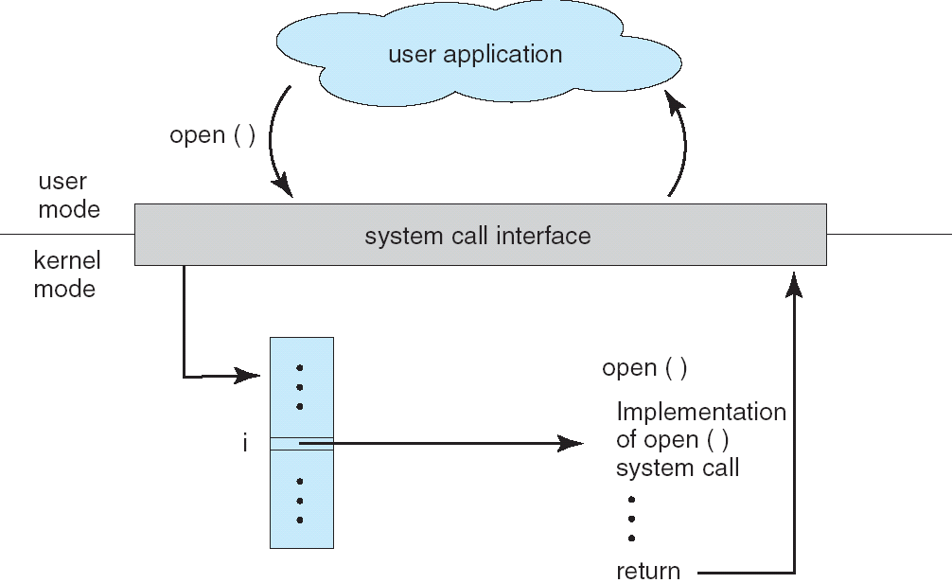
System Call – OS Relationship
i的含义？

Slide 25
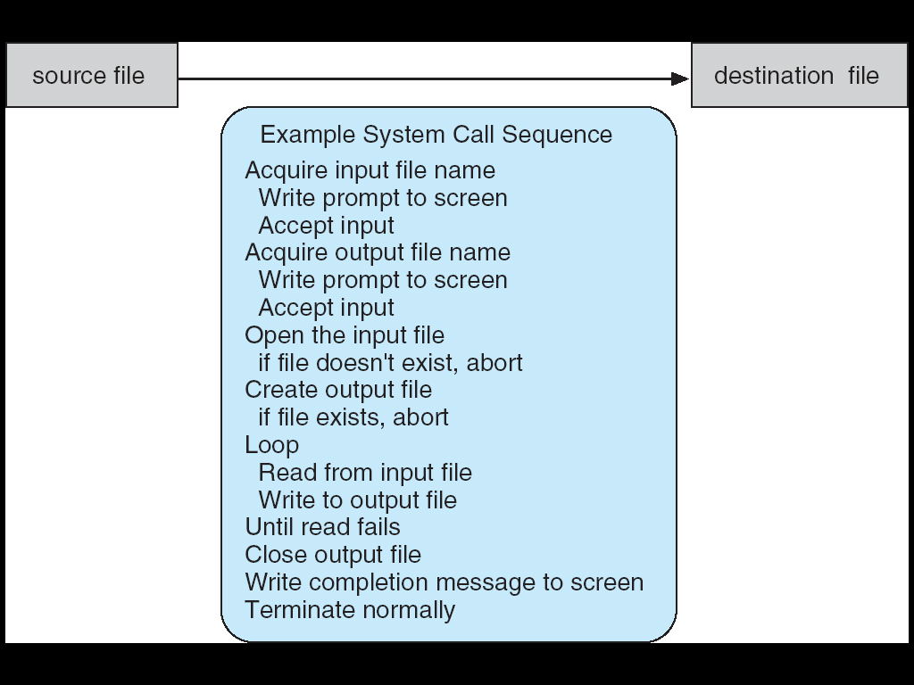
Example of System Calls
System call sequence to copy the contents of one file to another file

Slide 26
System Calls例
读取键盘按键，并将其输出到屏幕上
以Linux为例
//System Call
…
char c;
read(0,&c,1); //0-stdin
write(1,&c,1); //1-stdout
c=‘\n’;
write(1,&c,1);
….
// System Call
//另一种形式
…
char c[2];
read(0,&c[0],1);
c[1]=‘\n’;
write(1,c,2);
….

Slide 27
API -- Application Program Interface
API: a set of functions that are available to an application programmer
例如，C语言标准函数库为用户提供的是API接口
Mostly accessed by programs via a high-level API rather than direct system call use
思考：
Why use APIs rather than system calls?

Slide 28
API vs. System Calls
读取键盘按键，并将其输出到屏幕上
//API：
…
char c;
c=getchar();
printf(“%c\n”,c);
….
//System Call
…
char c;
read(0,&c,1); //0-stdin
write(1,&c,1); //1-stdout
c=‘\n’;
write(1,&c,1);
….
Why use APIs rather than system calls?
Program portability
More difficult to work with the system call
But more efficiency for some devices based on dedicated OS

Slide 29
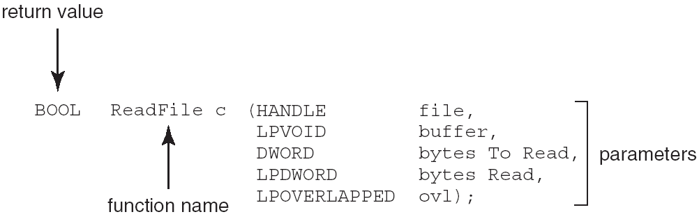
Example of Standard API
Consider the ReadFile() function in the Win32 API—a function for reading from a file
A description of the parameters passed to ReadFile()
HANDLE file—the file to be read
LPVOID buffer—a buffer where the data will be read into and written from
DWORD bytesToRead—the number of bytes to be read into the buffer
LPDWORD bytesRead—the number of bytes read during the last read
LPOVERLAPPED ovl—indicates if overlapped I/O is being used

Slide 30
API vs. System
API是通过调用相应的System call来实现的
思考：C函数printf()的实现过程？

Slide 31
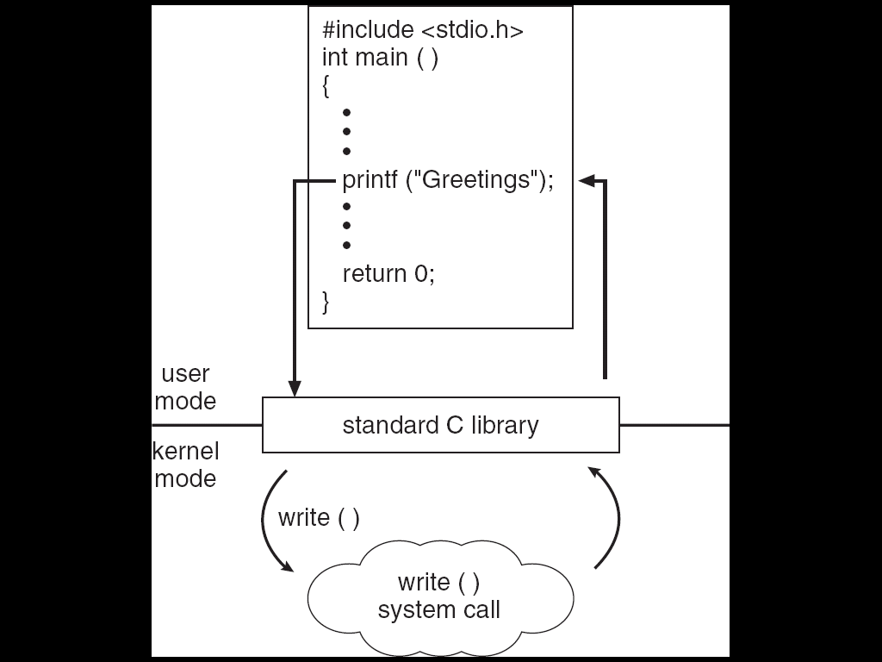
API：Standard C Library Example
C program invoking printf() library call, which calls write() system call
API—
Program portability
printf()函数库中，有一条特殊的指令trap，将CPU的执行模式从用户态陷入到核心态。
System Call–
More difficult to work
Non-portability
返回到printf()函数中， trap的下一条指令，解析系统调用的返回结果，然后返回到用户态，并给用户程序返回函数的执行结果。

Slide 32
System Call Implementation
Typically, a number associated with each system call
System-call interface maintains a table indexed according to these numbers
Similar to the Interrupt vector
The system call interface invokes intended system call in OS kernel and returns status of the system call and any return values
The caller need know nothing about how the system call is implemented

Slide 33
System Call Implementation
参见《UNIX操作系统设计》，P127

Slide 34
System Call
根据系统调用号，查找系统调用向量表，转到对应的系统调用处理程序
类似于中断向量表

Slide 35
System Call Parameter Passing
Three general methods used to pass parameters to the OS
1、Simplest: pass the parameters in registers
In some cases, may be more parameters than registers
2、Parameters placed, or pushed, onto the stack by the program and popped off the stack by the operating system
3、Parameters stored in a block, or table, in memory, and address of block passed as a parameter in a register
This approach taken by Linux and Solaris
Block and stack methods do not limit the number or length of parameters being passed

Slide 36
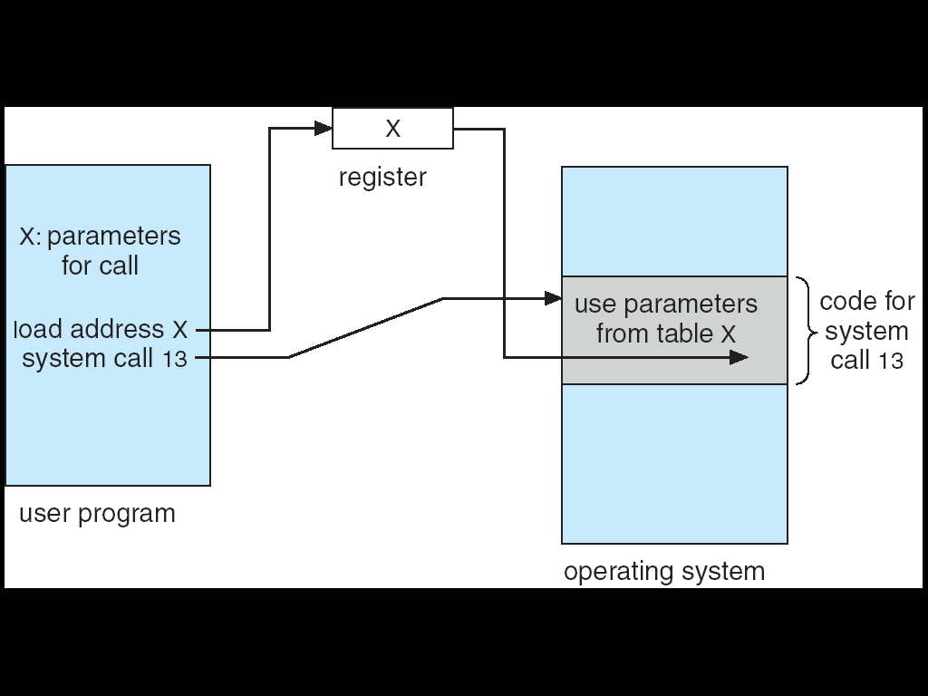
Parameter Passing via Table
2

Slide 37
课外阅读：System Call 接口与实现
系统调用接口及实现参见“UNIX操作系统设计”
6.4.3节，P126
Nachos课设6、7、8，设计实现几个系统调用
Xv6中需要实现几个系统调用

Slide 38
单选题
答案解析
1分
答案解析
下列选项中，操作系统提供给应用程序的接口是（）。（2010）
此题未设置答案，请点击右侧设置按钮
A
中断：不能直接调用
库函数：编程语言函数库提供，不是OS提供
原语：只是一个程序段，需要保证其执行过程的原子性
A
系统调用
B
中断
C
库函数
D
原语
提交
可为此题添加文本、图片、公式等解析，且需将内容全部放在本区域内。正常使用需3.0以上版本

Slide 39
单选题
答案解析
1分
答案解析
执行系统调用的过程包括如下主要操作：
1、返回用户态 2、执行陷入（trap）指令
3、传递系统调用参数 4、执行相应的服务程序
正确的执行顺序是（）。
此题未设置答案，请点击右侧设置按钮
C
A
2→3→1→4
B
2→4→3→1
C
3→2→4→1
D
3→4→2→1
提交
可为此题添加文本、图片、公式等解析，且需将内容全部放在本区域内。正常使用需3.0以上版本

Slide 40
2.4 Types of System Calls
Process control
File management
Device management
Information maintenance
Communications

Slide 41
System Calls：Process control
end, abort
load, execute
create process, terminate process
get process attributes, set process attributes
wait for time
wait event, signal event
allocate and free memory

Slide 42
System Calls：File management
create file, delete file
open, close
read, write, reposition
get file attributes, set file attributes

Slide 43
System Calls： Device management
request device, release device
read, write, reposition
get device attributes, set device attributes
logically attach or detach devices

Slide 44
System Calls： Information maintenance
get time or date, set time or date
get system data, set system data
get process, file, or device attributes
set process, file, or device attributes

Slide 45
System Calls： Communications
create, delete communication connection
send, receive messages
transfer status information
attach or detach remote devices

Slide 46
EXAMPLES OF WINDOWS AND UNIX SYSTEM CALLS
Windows Unix
Process CreateProcess() fork()
Control ExitProcess() exit()
WaitForSingleObject() wait()
File CreateFile() open()
Manipulation ReadFile() read()
WriteFile() write()
CloseHandle() close()
Device SetConsoleMode() ioctl()
Manipulation ReadConsole() read()
WriteConsole() write()
Information GetCurrentProcessID() getpid()
Maintenance SetTimer() alarm()
Sleep() sleep()
Communication CreatePipe() pipe()
CreateFileMapping() shm_open()
MapViewOfFile() mmap()
Protection SetFileSecurity() chmod()
InitlializeSecurityDescriptor() umask()
SetSecurityDescriptorGroup() chown()

Slide 47
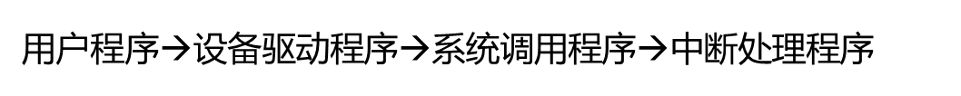
单选题
答案解析
1分
答案解析
用户程序发出磁盘I/O请求后，操作系统系统正确的处理流程是（）。
此题未设置答案，请点击右侧设置按钮
B
A
用户程序→系统调用程序→中断处理程序→设备驱动程序
B
用户程序$\text{→}$系统调用程序$\text{→}$设备驱动程序$\text{→}$中断处理程序
C
用户程序$\text{→}$设备驱动程序$\text{→}$系统调用程序$\text{→}$中断处理程序
D
用户程序$\text{→}$设备驱动程序$\text{→}$中断处理程序→系统调用程序
提交
可为此题添加文本、图片、公式等解析，且需将内容全部放在本区域内。正常使用需3.0以上版本

Slide 48
单选题
答案解析
1分
答案解析
下列选项中，会导致用户进程从用户态切换到内核态的操作是（）。
I. 整数除以0 II. sin()函数调用 III. read系统调用
此题未设置答案，请点击右侧设置按钮
B
A
仅 I、II
B
仅 I、III
C
仅 II、III
D
I、II 和 III
提交
可为此题添加文本、图片、公式等解析，且需将内容全部放在本区域内。正常使用需3.0以上版本

Slide 49
2.5 System Programs
System programs provide a convenient environment for program development and execution. They can be divided into:
File manipulation
Status information
File modification
Programming language support
Program loading and execution
Communications
Application programs
Most users’ view of the operating system is defined by system programs, not the actual system calls

Slide 50
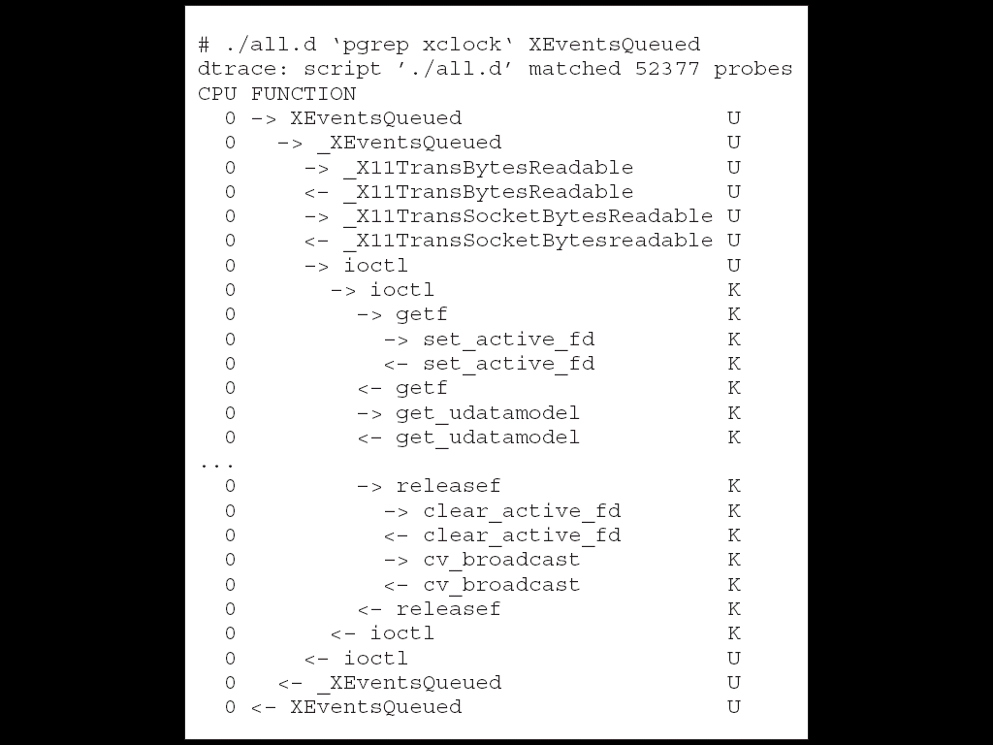
Solaris 10 dtrace Following System Call

Slide 51
系统跟踪工具-dtrace
Windows等提供Core Dump方法, 将运行时刻的内存复制到一个文件中. 通过工具比如dbx, mdb来对这个内存文件进行分析,找到当初产生问题的原因；
UNIX/Linux系统提供一些统计分析工具, 如vmstat,iostat,mpstat。这些工具可以提供一些系统级别的统计分析信息，但是缺乏对每个进程,每个用户的分析和统计的能力；
Dtrace 是Solaris 10上的一个新功能；
通过Dtrace，用户可以实时跟踪、调节系统并进行故障排除；
Dtrace是一个动态的可观测框架；
可以让用户到看整个Solaris内部感兴趣的任何数据；
配合以Dtrace 简单易学的D语言, 管理员可以发现先前隐蔽的问题；
而对于开发人员来说，通过观察Dtrace内核之间的活动，可以分析和优化应用程序性能，缩短了测试周期；

Slide 52
System Programs
Provide a convenient environment for program development and execution
Some of them are simply user interfaces to system calls; others are considerably more complex
File management - Create, delete, copy, rename, print, dump, list, and generally manipulate files and directories
Status information
Some ask the system for info - date, time, amount of available memory, disk space, number of users
Others provide detailed performance, logging, and debugging information
Typically, these programs format and print the output to the terminal or other output devices
Some systems implement a registry - used to store and retrieve configuration information

Slide 53
System Programs (cont’d)
File modification
Text editors to create and modify files
Special commands to search contents of files or perform transformations of the text
Programming-language support - Compilers, assemblers, debuggers and interpreters sometimes provided
Program loading and execution- Absolute loaders, relocatable loaders, linkage editors, and overlay-loaders, debugging systems for higher-level and machine language
Communications - Provide the mechanism for creating virtual connections among processes, users, and computer systems
Allow users to send messages to one another’s screens, browse web pages, send electronic-mail messages, log in remotely, transfer files from one machine to another

Slide 54
2.6 Operating System Design and Implementation
Design and Implementation of OS not “solvable”, but some approaches have proven successful
Internal structure of different Operating Systems can vary widely
Batch, time sharing, single user, multiuser, distributed, real time, or general purpose.
Start by defining goals and specifications
Affected by choice of hardware, type of system
User goals and System goals
User goals – operating system should be convenient to use, easy to learn, reliable, safe, and fast
System goals – operating system should be easy to design, implement, and maintain, as well as flexible, reliable, error-free, and efficient

Slide 55
Operating System Design and Implementation (Cont.)
Important principle to separate
Policy: What will be done?
Policies decide what will be done（做什么？）
Mechanism: How to do it?
Mechanisms determine how to do something（如何做？）
例如
Mechanism：如何对CPU进行保护→采用定时器（如何做？）
Policy：对于特定用户将定时器设置多长时间（做什么？）
The separation of policy from mechanism is a very important principle,
It allows maximum flexibility if policy decisions are to be changed later

Slide 56
2.7 System Structure
Simple structure
Layered approach
Microkernels
Modules
Virtual Machines

Slide 57
2.7.1 Simple structure
MS-DOS System Structure
MS-DOS – written to provide the most functionality in the least space
Not divided into modules
Although MS-DOS has some structure, its interfaces and levels of functionality are not well separated

Slide 58
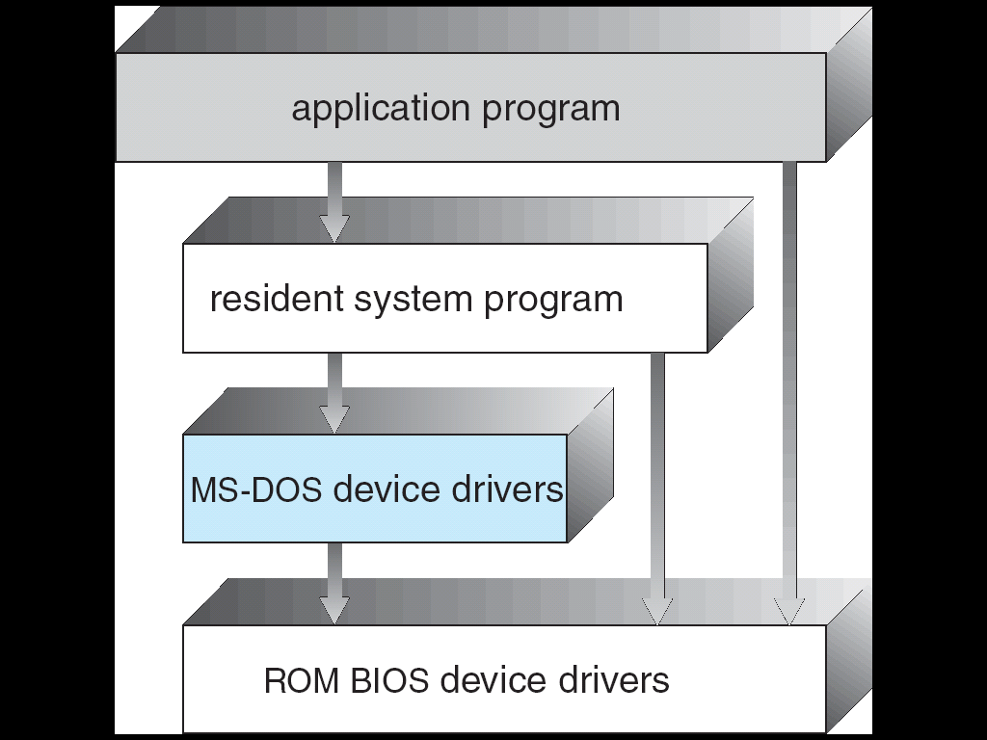
MS-DOS Layer Structure (Cont.)
由于内存太小，操作系统一部分常驻内存（内核），一部分可被应用程序临时覆盖，程序退出时再将它们重新装入到内存。

Slide 59
2.7.2 Layered Approach
The operating system is divided into a number of layers (levels), each built on top of lower layers. The bottom layer (layer 0), is the hardware; the highest (layer N) is the user interface.
With modularity, layers are selected such that each uses functions (operations) and services of only lower-level layers

Slide 60
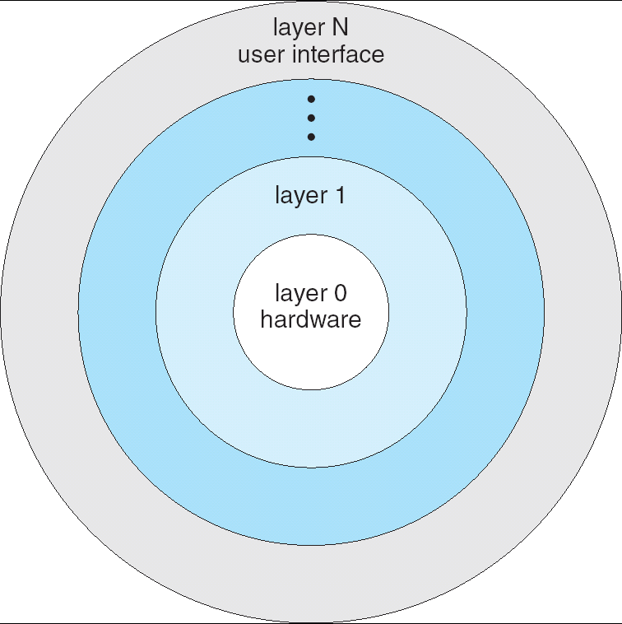
Layered Operating System (cont.)

Slide 61
回顾：思考
A key design question is what part of the operating system should run in supervisor mode
设计时可以考虑的一些因素
faster performance
smaller code size
reliability of the kernel
reliability of the complete operating system (including user-level services)
portability
etc

Slide 62
回顾：Monolithic kernel
Monolithic kernel（单一内核，宏内核）
The entire operating system resides in the kernel, so that the implementations of all system calls run in supervisor mode
Entire operating system runs with full hardware privilege
Merit
Convenient：the OS designer doesn’t have to decide which part of the operating system doesn’t need full hardware privilege
Faster performance：it is easier for different parts of the operating system to cooperate. For example, the file system and the virtual memory system can share a buffer cache.
Downsize
The interfaces between different parts of the operating system are often complex
It is easy for an operating system developer to make a mistake

Slide 63
UNIX
UNIX – limited by hardware functionality, the original UNIX operating system had limited structuring.
The UNIX OS consists of two separable parts
Systems programs
The kernel
Consists of everything below the system-call interface and above the physical hardware
Provides the file system, CPU scheduling, memory management, and other operating-system functions
Monolithic kernel，宏内核

Slide 64
UNIX System Structure
Monolithic kernel，宏内核

Slide 65
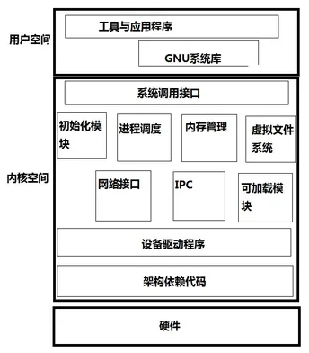
UNIX 层次结构

Slide 66
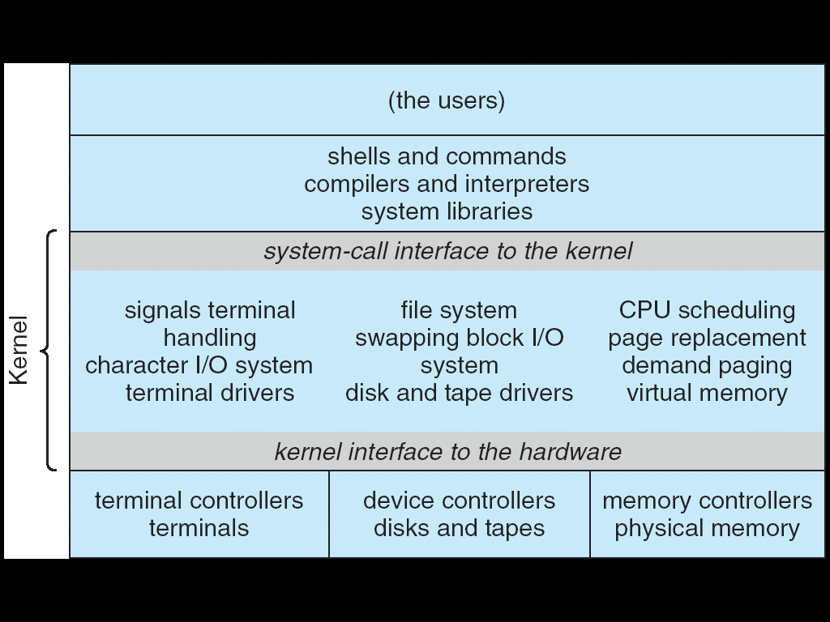
UNIX System Structure
Monolithic kernel
系统程序
内核：系统调用接口以下，硬件以上；
类似于Windows NT的HAL(见下页)
hardware

Slide 67
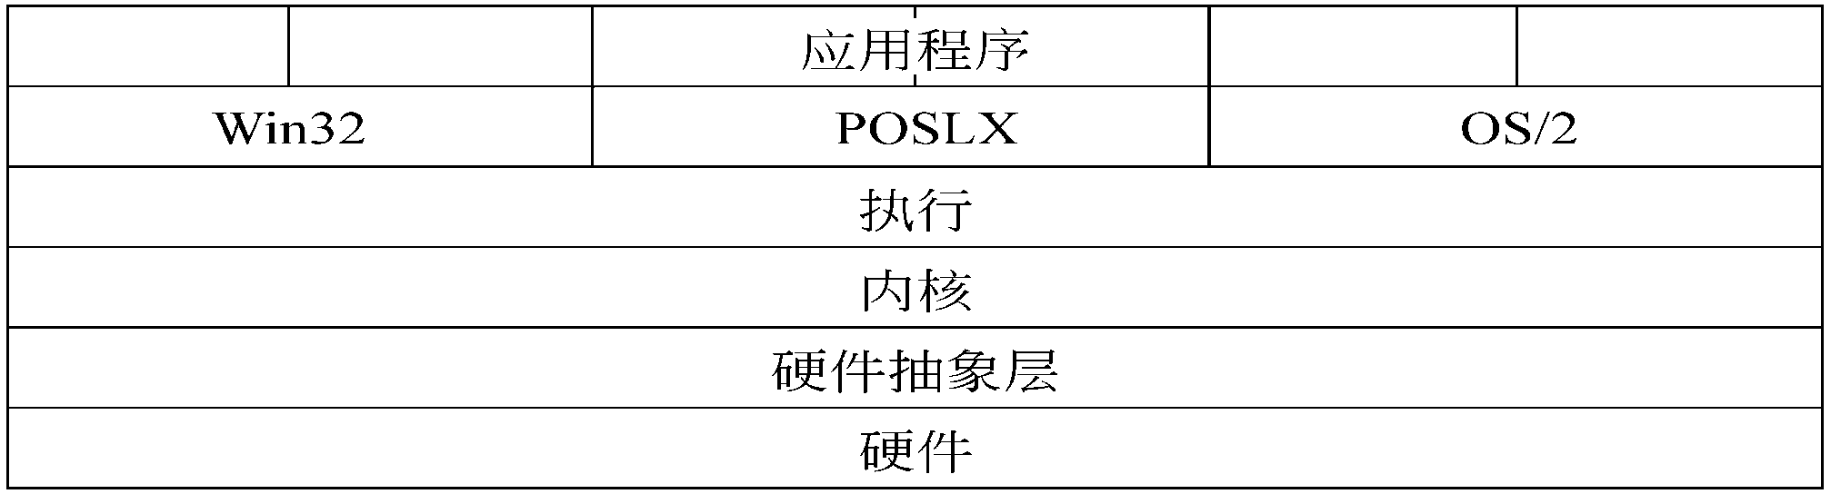
Windows NT
硬件抽象层（Hardware Abstraction Layer，HAL）：是对架构和硬件相关性的封装。主要是为了Windows NT的可移植性。
内核：主要提供进（线）程调度、同步和中断处理等服务。
执行：提供其他常用的操作系统功能，包括存储管理、文件系统和一些进程管理。系统调用也由其来处理。
应用程序： Windows NT提供了三个环境子系统：Win32、POSIX和OS/2。用这些API中任何一个编写的应用程序都可以在Windows NT上运行。
POSIX--Portable Operating System Interface，其中的X表示对Unix API的传承

Slide 68
Android System Structure
Architecture of Google’s Android.

Slide 69
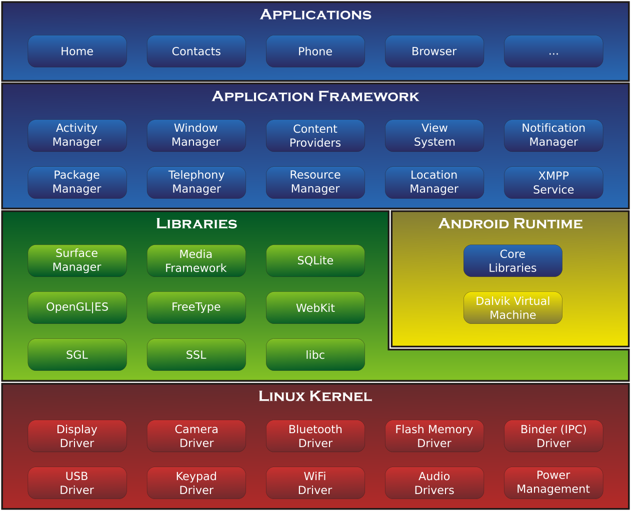
Android System Structure

Slide 70
Microkernel System Structure
Moves as much from the kernel into “user” space
The kernel interface consists of a few low-level functions for starting applications, sending messages, accessing device hardware, etc
Other system, such as file system, device driver runs as a user-level process
OS services running as processes are called servers
Communication takes place between user modules and kernel using message passing
华为的鸿蒙操作系统--微内核结构
Mach微内核
Macintosh（Mac）系统基于mach微内核结构

Slide 71
Microkernel System Structure
Architecture of a typical microkernel

Slide 72
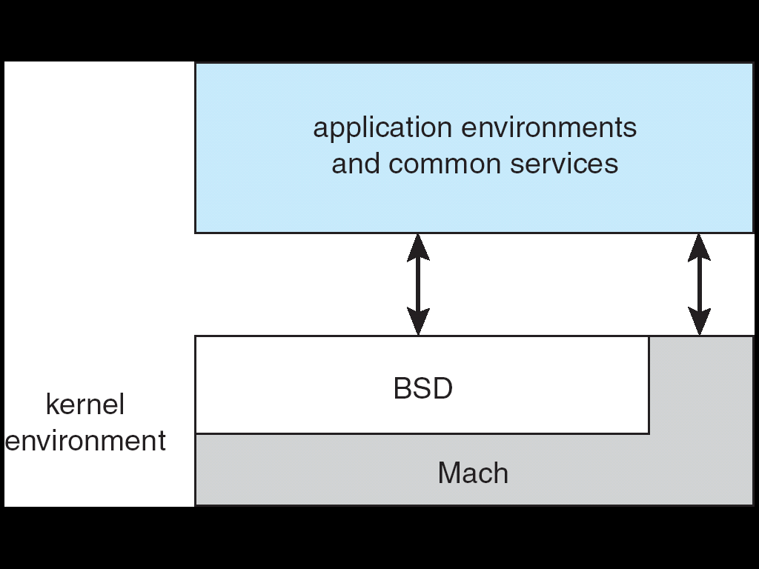
Mac OS X Structure（iOS）
BSD (Berkeley Software Distribution
Mac(Macintosh)系统
基于Mach微内核设计，可运行Mach-O格式的可执行文件
其内核也包括了BSD内核，对BSD UNIX应用程序有很好的支持
在mac上可很好地运行UNIX应用程序

Slide 73
Mach
Mach是一个由卡内基梅隆大学开发的用于支持操作系统研究的一个操作系统内核
为了用于操作系统之研究
强调分布式与并行运算
有的Mac OS使用了Mach内核
设计Mach的目的是替代传统的UNIX内核
Mach是一个真正的微内核系统，是最早实现的微核心操作系统之一，是许多其它相似的项目的标准
Mach的开发者意欲取名为MUCK（mʌtʃ）
Multi-User Communication Kernel，或
Multiprocessor Universal Communication Kernel
开发者的一个意大利同事错将MUCK发音为MACH （mɑːk; mæk）

Slide 74
Tips：BSD
BSD--Berkeley Software Distribution
BSD是Unix的衍生系统，在1977至1995年间由加州大学伯克利分校开发和发布
历史上， BSD曾经被认为是UNIX的一支—"BSD UNIX", 因为它和AT&T UNIX操作系统共享基础代码和设计
在20世纪80年代，衍生出了许多变形的UNIX授权软件
比较著名的如DEC的Ultrix及Sun公司的SunOS
1990年代，BSD很大程度上被System V4.x版以及OSF/1系统所取代，晚期BSD版本为几个开源软件开发提供了平台并且一直沿用至今
现在“BSD”并不特指任何一个BSD衍生版本，而是类UNIX操作系统中的一个分支的总称。

Slide 75
Microkernel System Structure
Benefits:
Easier to extend a microkernel
Easier to port the operating system to new architectures
More reliable (less code is running in kernel mode)
More secure
Detriments:
Performance overhead of user space to kernel space communication
Difficult to design: the OS designer have to decide which part of the operating system need full hardware privilege, and which part doesn't need

Slide 76
2.7.4 Modules
Most modern operating systems implement kernel modules
Uses object-oriented approach
Each core component is separate
Each talks to the others over known interfaces
Each is loadable as needed within the kernel
Overall, similar to layers but with more flexible

Slide 77
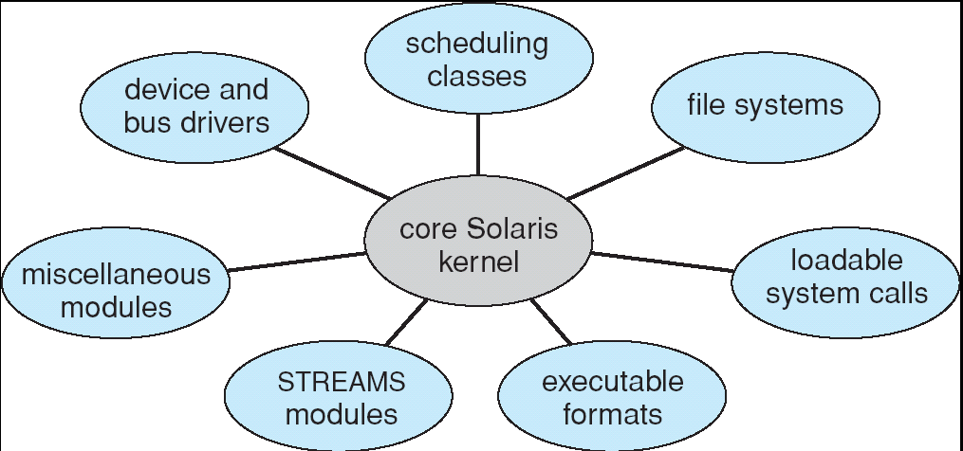
Solaris Modular Approach

Slide 78
Mac OS X Structure
有的Mac版本采用混合结构：layerd，microkernel，modules

Slide 79
2.8 Virtual Machines
虚拟机（Virtual Machine）是指可以像真实机器一样运行程序的计算机的软件实现，是通过软件模拟的具有完整硬件系统功能的、运行在一个完全隔离环境中的完整计算机系统。
几个虚拟机例
JVM (与通用虚拟机概念有些区别)
VMware
VirtualBox

Slide 80
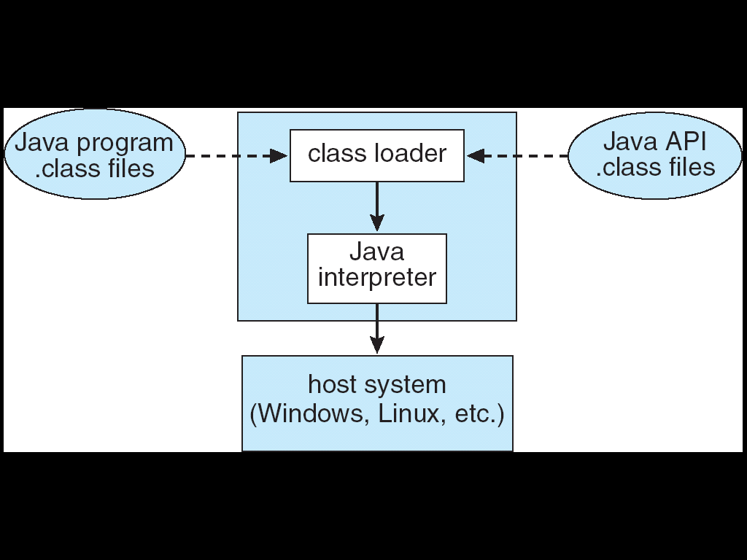
The Java Virtual Machine

Slide 81
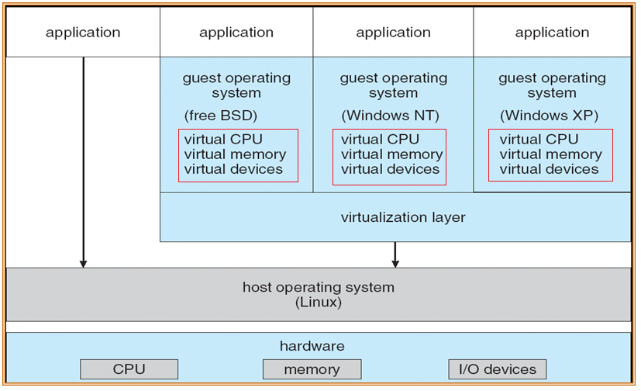
VMware Architecture

Slide 82
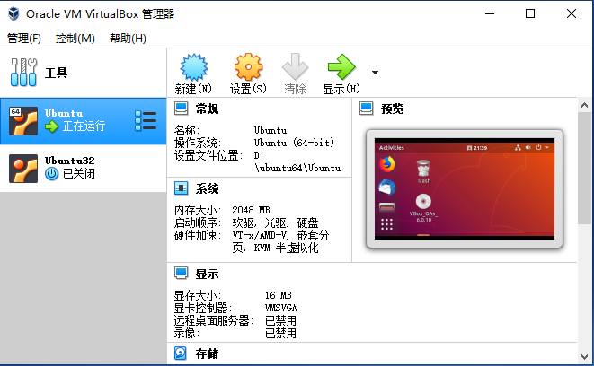
VirtualBox虚拟机

Slide 83
上述虚拟机例的共同点
基于宿主操作系统上实现（Host Operating System ）
如基于Windows，Linux等实现
提供一个虚拟层，将一套真实的硬件系统虚拟成多套硬件系统
如Virtual Memory, Virtual CPU， Virtual Devices，etc
相当于提供了多套硬件系统
在每套虚拟硬件上可以安装不同的操作系统

Slide 84
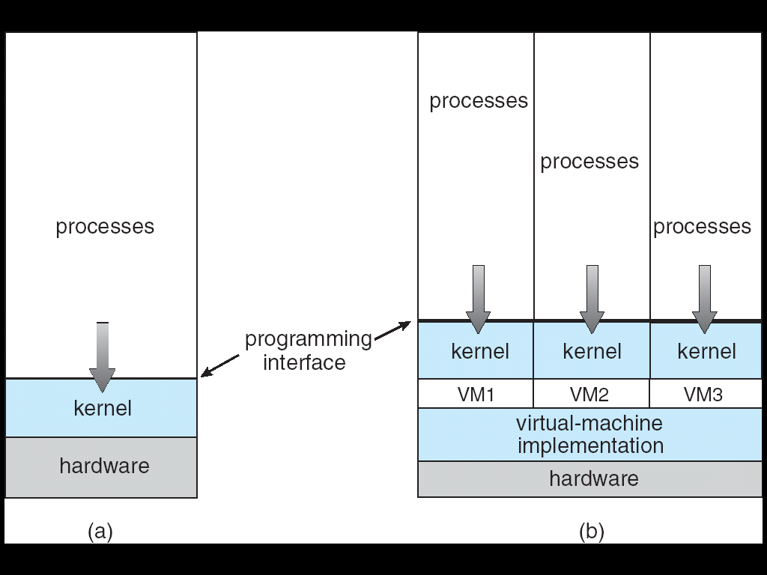
Virtual Machines
(a) Nonvirtual machine (b) virtual machine
Non-virtual Machine
Virtual Machine

Slide 85
VMware Architecture（回顾）

Slide 86
Virtual Machines(Cont.)
A virtual machine takes the layered approach to its logical conclusion.
It treats hardware and the operating system kernel as though they were all hardware
A virtual machine provides an interface identical to the underlying bare hardware
The operating system creates the illusion of multiple processes, each executing on its own processor with its own (virtual) memory

Slide 87
Virtual Machines (Cont.)
The resources of the physical computer are shared to create the virtual machines
CPU scheduling can create the appearance that users have their own processor
Spooling and a file system can provide virtual card readers and virtual line printers
A normal user time-sharing terminal serves as the virtual machine operator’s console

Slide 88
Virtual Machines (Cont.)
The virtual-machine concept provides complete protection of system resources
Since each virtual machine is isolated from all other virtual machines.
This isolation, however, permits no direct sharing of resources.
A virtual-machine system is a perfect vehicle for operating-systems research and development.
System development is done on the virtual machine, instead of on a physical machine and so does not disrupt normal system operation.
The virtual machine concept is difficult to implement due to the effort required to provide an exact duplicate to the underlying machine

Slide 89
2.9 Operating System Generation
Operating systems are designed to run on any of a class of machines; the system must be configured for each specific computer site
SYSGEN program obtains information concerning the specific configuration of the hardware system
Booting – starting a computer by loading the kernel
Bootstrap program – code stored in ROM that is able to locate the kernel, load it into memory, and start its execution

Slide 90
2.10 System Boot
Operating system must be made available to hardware so hardware can start it
Small piece of code – bootstrap loader, locates the kernel, loads it into memory, and starts it
Sometimes two-step process where boot block at fixed location loads bootstrap loader
When power initialized on system, execution starts at a fixed memory location
Firmware used to hold initial boot code

Slide 91
课后复习题
本章要点
Operating System Services (two categories)；
Two interfaces to those services for users；
Concept of system call；
Three general methods for system Call Parameters Passing；
结合系统调用的概念，解释系统对c函数，如printf(“Hello World\n”)的实现或处理过程；
Operating System Design and Implementation
层次结构、微内核、模块化、虚拟机
思考
第7版：Page 73： 3，6，12, 14
第9版：2.1,2.5.2.8,2.16，2.21

Slide 92
End of Chapter 2

